Slide 1

WEEK 4 - Matrices and Determinants Systems of Linear Equations in Two Variables Systems of Linear Equations in Three Variables WEEK 5 – Nonlinear Systems of equations Applications of Systems of Equations Partial Fractions WEEK 6 – Inequalities in Two Variables and System and Systems of Inequalities Linear Programming

Slide 2
Matrices and Determinants

Slide 3
SPECIFIC OBJECTIVES:
At the end of the lesson, the student is expected to be able to:
define matrix
identify different types of matrices.
define determinant of a square matrix.
evaluate determinant of a square matrix.

Slide 4
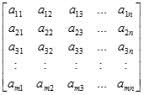
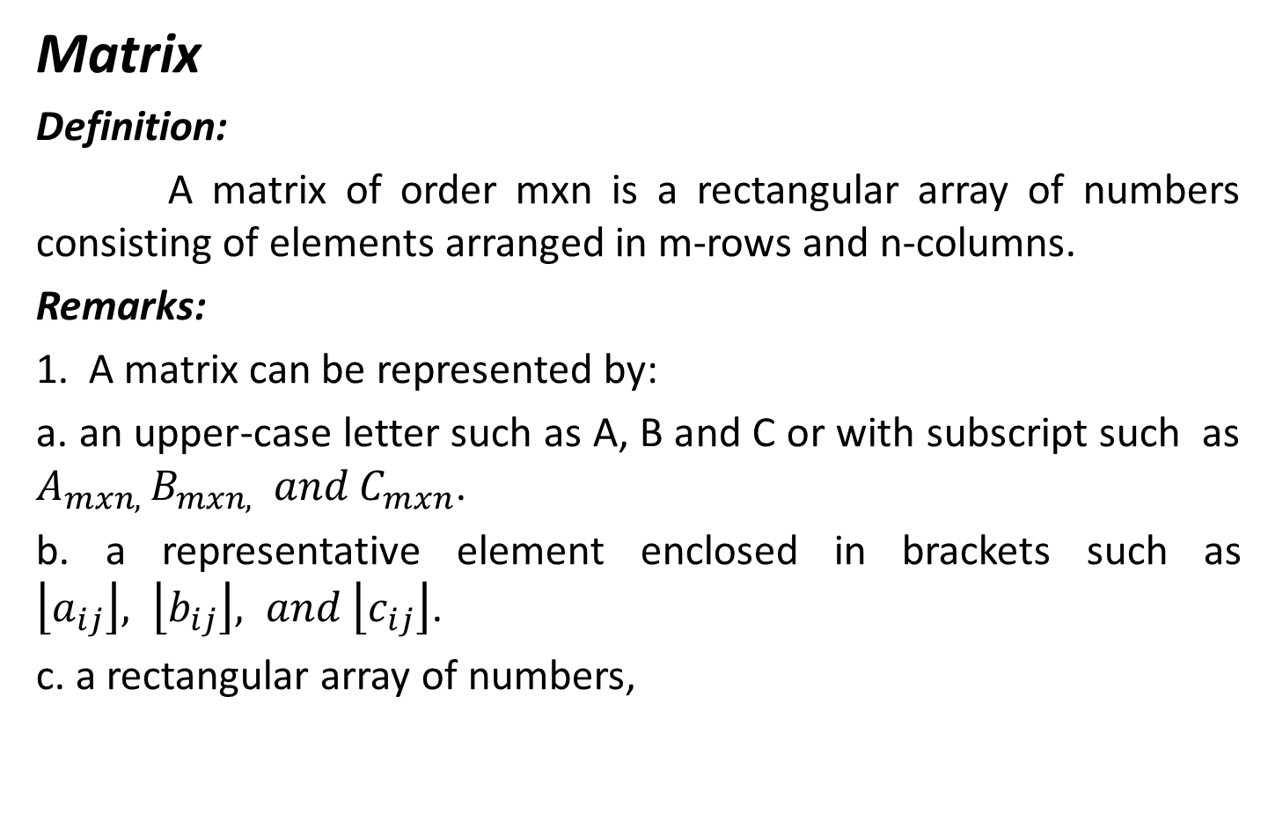
Matrix
Definition:
A matrix of order mxn is a rectangular array of numbers consisting of elements arranged in m-rows and n-columns.
Remarks:
1. A matrix can be represented by:
a. an upper-case letter such as A, B and C or with subscript such as $A_{mxn, }B_{mxn,} and C_{mxn}$.
b. a representative element enclosed in brackets such as $\left\lfloor a_{ij}\right\rfloor , \left\lfloor b_{ij}\right\rfloor , and \left\lfloor c_{ij}\right\rfloor$.
c. a rectangular array of numbers,

Slide 5
2. Two matrices are equal if and only if their orders are equal and corresponding elements are equal.
3. A square matrix is one where the number of rows is equal to the number of columns.
4. A matrix with only one row is a row matrix while that with only one column is a column matrix.
5. An identity matrix is a square matrix where the elements in the main diagonal are all 1’s and the other elements are 0’s.

Slide 6
6. A zero matrix is one where all elements are zero.
7. A diagonal matrix is a square matrix with off-main diagonal entries all zeros.
8. A zero-one matrix is a matrix consisting of zeros and ones only as entries.
9. The transpose of a matrix , denoted by A^{T} , is obtained by interchanging the rows and columns of the matrix.

Slide 7
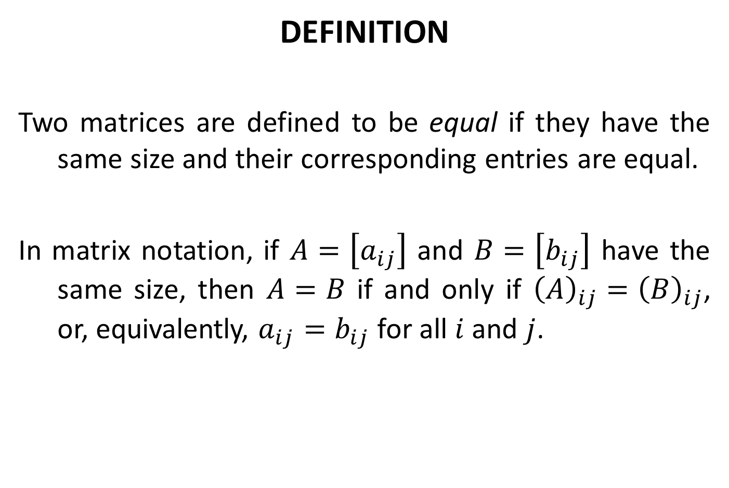
DEFINITION
Two matrices are defined to be equal if they have the same size and their corresponding entries are equal.
In matrix notation, if $A=\left[a_{ij}\right]$ and $B=\left[b_{ij}\right]$ have the same size, then $A=B$ if and only if ${\left(A\right)}_{ij}={\left(B\right)}_{ij}$, or, equivalently, $a_{ij}=b_{ij}$ for all $i$ and $j$.

Slide 8
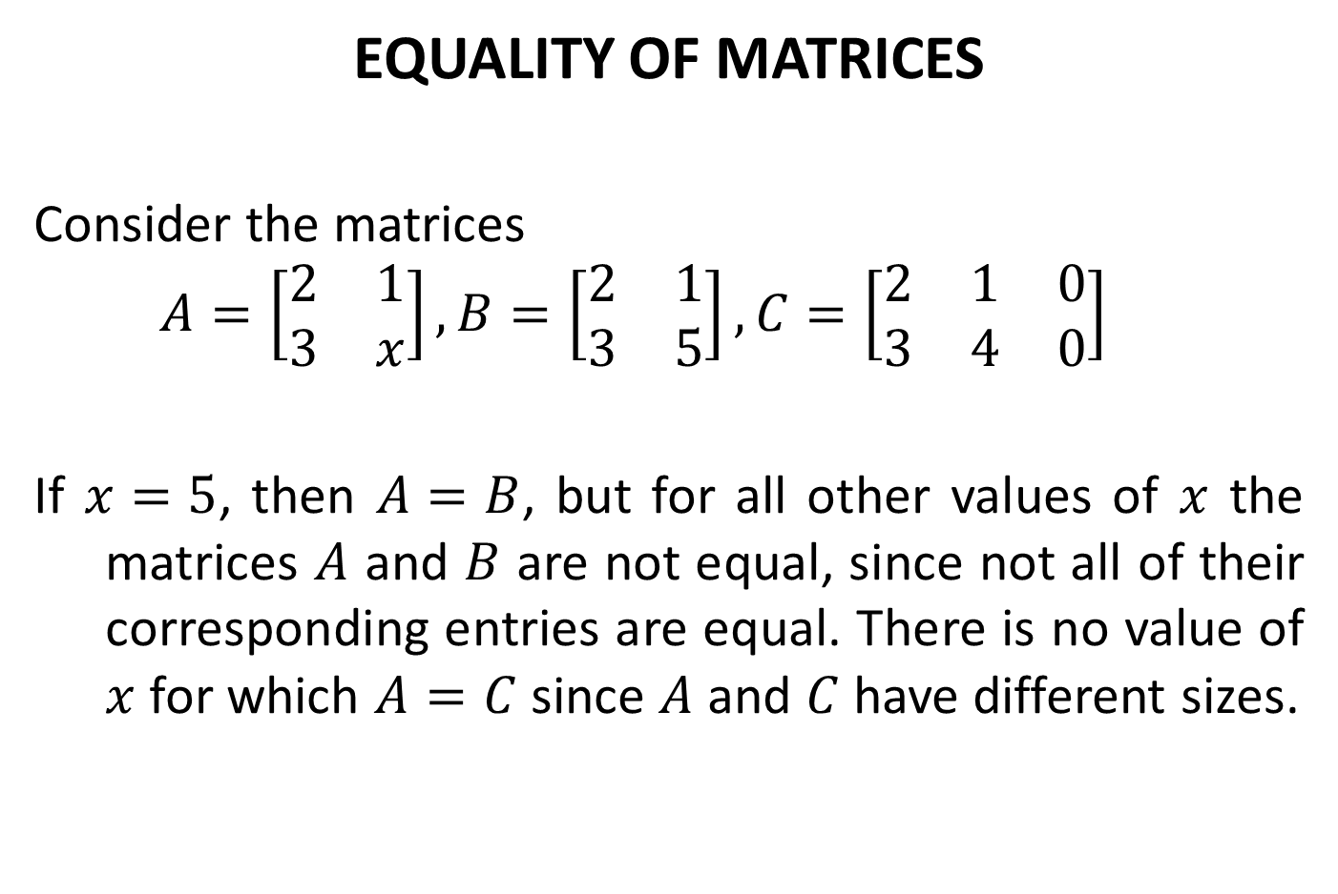
EQUALITY OF MATRICES
Consider the matrices
$$A=\left[\begin{matrix}2 & 1 \\ 3 & x\end{matrix}\right], B=\left[\begin{matrix}2 & 1 \\ 3 & 5\end{matrix}\right], C=\left[\begin{matrix}2 & 1 & 0 \\ 3 & 4 & 0\end{matrix}\right]$$
If $x=5$, then $A=B$, but for all other values of $x$ the matrices $A$ and $B$ are not equal, since not all of their corresponding entries are equal. There is no value of $x$ for which $A=C$ since $A$ and $C$ have different sizes.

Slide 9
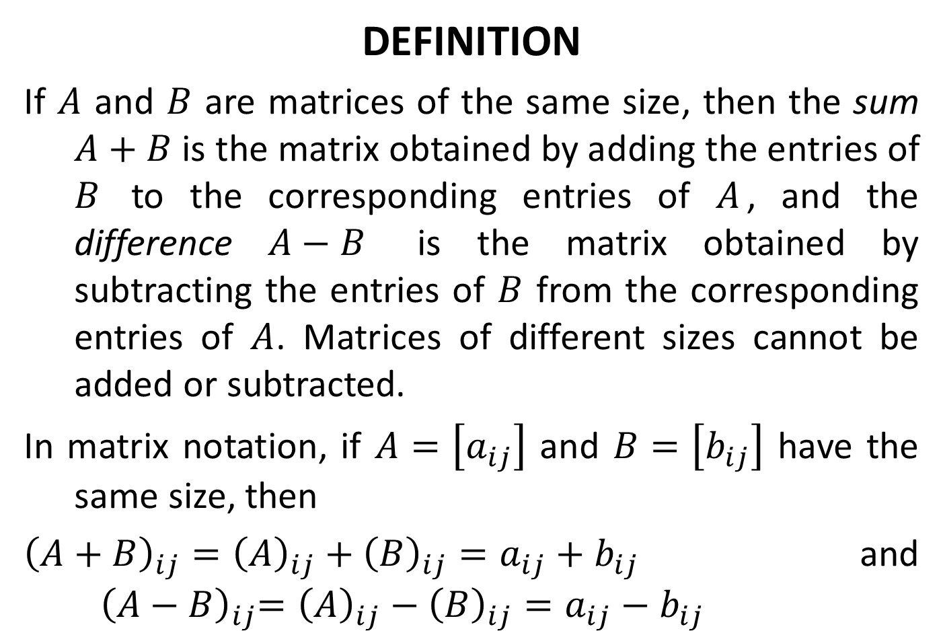
DEFINITION
If $A$ and $B$ are matrices of the same size, then the sum $A+B$ is the matrix obtained by adding the entries of $B$ to the corresponding entries of $A$, and the difference $A−B$ is the matrix obtained by subtracting the entries of $B$ from the corresponding entries of $A$. Matrices of different sizes cannot be added or subtracted.
In matrix notation, if $A=\left[a_{ij}\right]$ and $B=\left[b_{ij}\right]$ have the same size, then
${\left(A+B\right)}_{ij}={\left(A\right)}_{ij}+{\left(B\right)}_{ij}=a_{ij}+b_{ij}$and ${ \left(A−B\right)}_{ij}={\left(A\right)}_{ij}−{\left(B\right)}_{ij}=a_{ij}−b_{ij}$

Slide 10

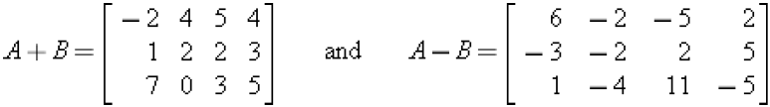

Consider the matrices
then
The expressions $A+C$, $B+C$, $A−C$, and $B−C$ are undefined.

Slide 11
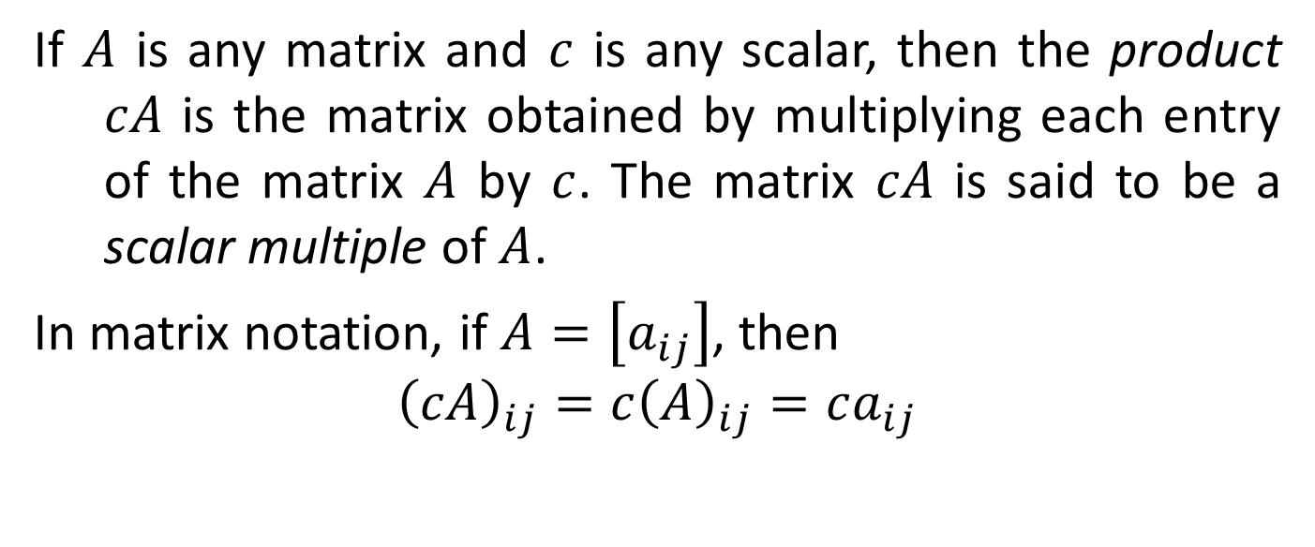
DEFINITION
If $A$ is any matrix and $c$ is any scalar, then the product $cA$ is the matrix obtained by multiplying each entry of the matrix $A$ by $c$. The matrix $cA$ is said to be a scalar multiple of $A$.
In matrix notation, if $A=\left[a_{ij}\right]$, then
$${\left(cA\right)}_{ij}=c{\left(A\right)}_{ij}=ca_{ij}$$

Slide 12

SCALAR MULTIPLES
For the matrices
we have
It is a common practice to denote $\left(−1\right)B$ by $−B$.

Slide 13
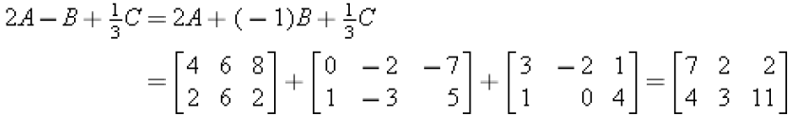
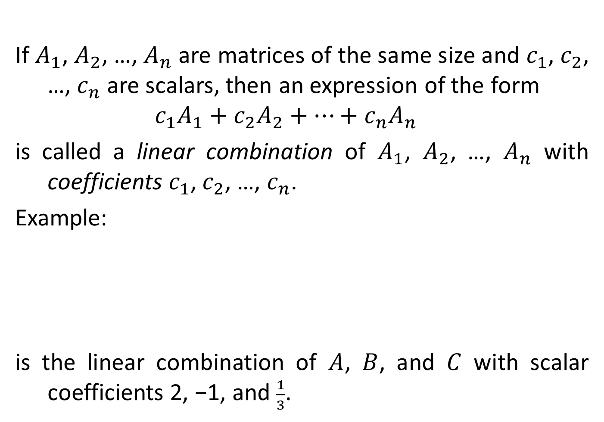
If $A_{1}$, $A_{2}$, …, $A_{n}$ are matrices of the same size and $c_{1}$, $c_{2}$, …, $c_{n}$ are scalars, then an expression of the form
$$c_{1}A_{1}+c_{2}A_{2}+⋯+c_{n}A_{n}$$
is called a linear combination of $A_{1}$, $A_{2}$, …, $A_{n}$ with coefficients $c_{1}$, $c_{2}$, …, $c_{n}$.
Example:
is the linear combination of $A$, $B$, and $C$ with scalar coefficients 2, −1, and $\frac{1}{3}$.

Slide 14
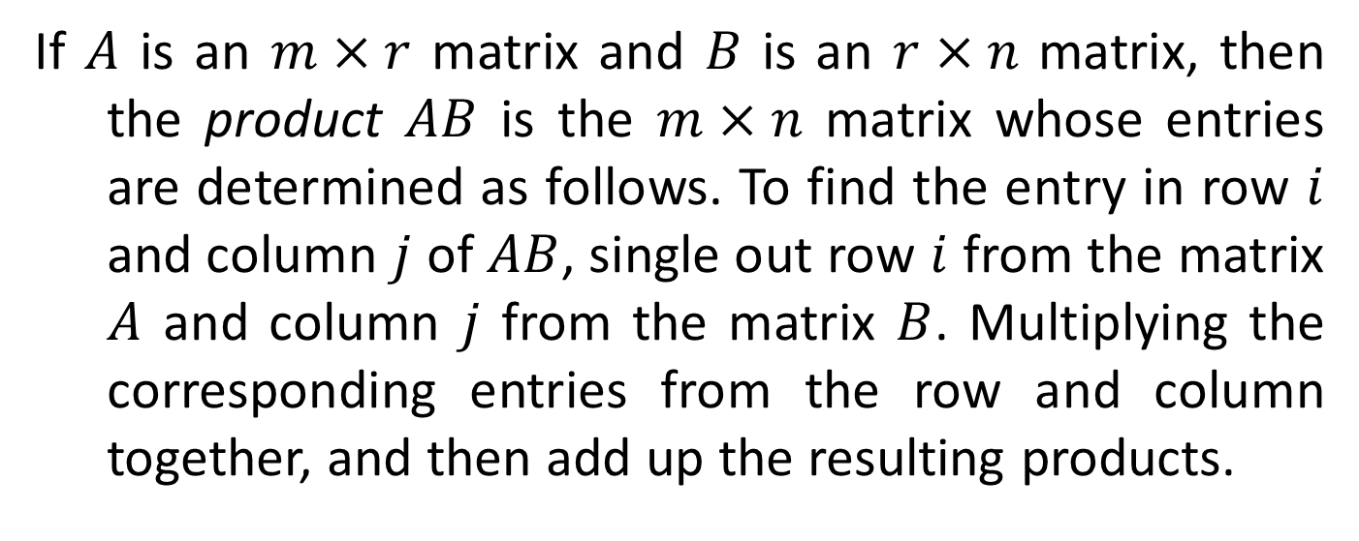
DEFINITION
If $A$ is an $m×r$ matrix and $B$ is an $r×n$ matrix, then the product $AB$ is the $m×n$ matrix whose entries are determined as follows. To find the entry in row $i$ and column $j$ of $AB$, single out row $i$ from the matrix $A$ and column $j$ from the matrix $B$. Multiplying the corresponding entries from the row and column together, and then add up the resulting products.

Slide 15
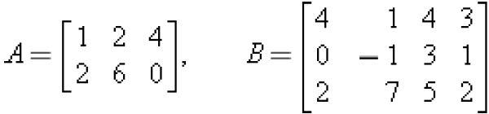
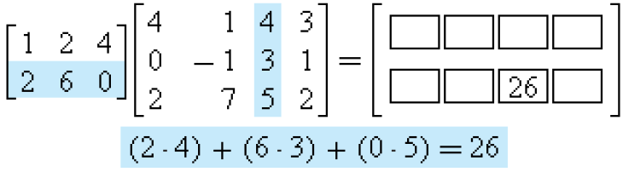
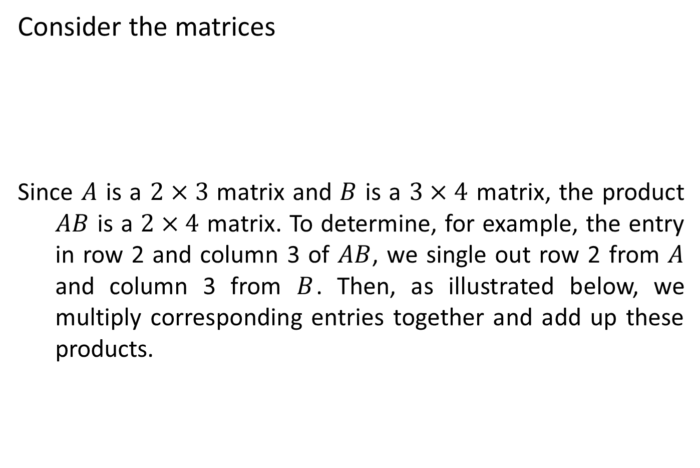
Consider the matrices
Since $A$ is a $2×3$ matrix and $B$ is a $3×4$ matrix, the product $AB$ is a $2×4$ matrix. To determine, for example, the entry in row 2 and column 3 of $AB$, we single out row 2 from $A$ and column 3 from $B$. Then, as illustrated below, we multiply corresponding entries together and add up these products.

Slide 16
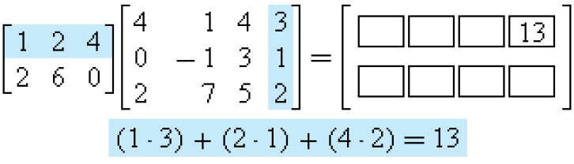
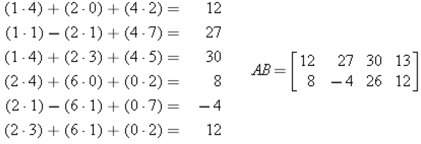

The entry in row 1 and column 4 of $AB$ is computed as follows:
The computations for the remaining entries are

Slide 17
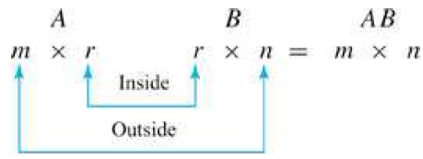
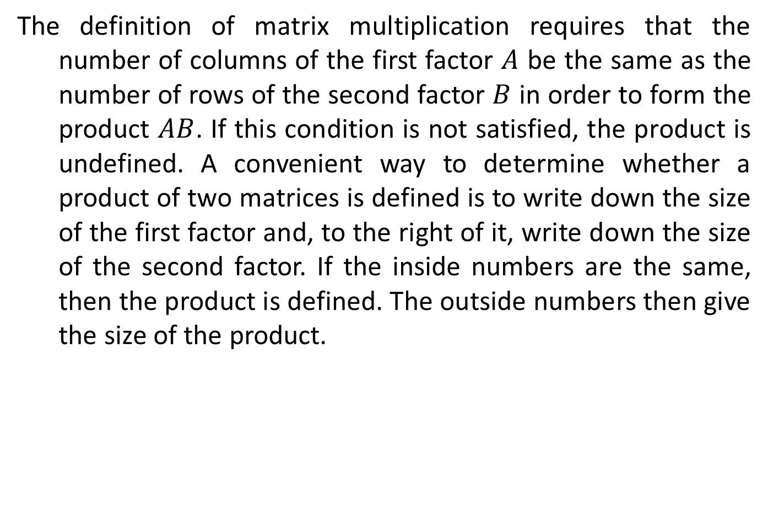
The definition of matrix multiplication requires that the number of columns of the first factor $A$ be the same as the number of rows of the second factor $B$ in order to form the product $AB$. If this condition is not satisfied, the product is undefined. A convenient way to determine whether a product of two matrices is defined is to write down the size of the first factor and, to the right of it, write down the size of the second factor. If the inside numbers are the same, then the product is defined. The outside numbers then give the size of the product.

Slide 18

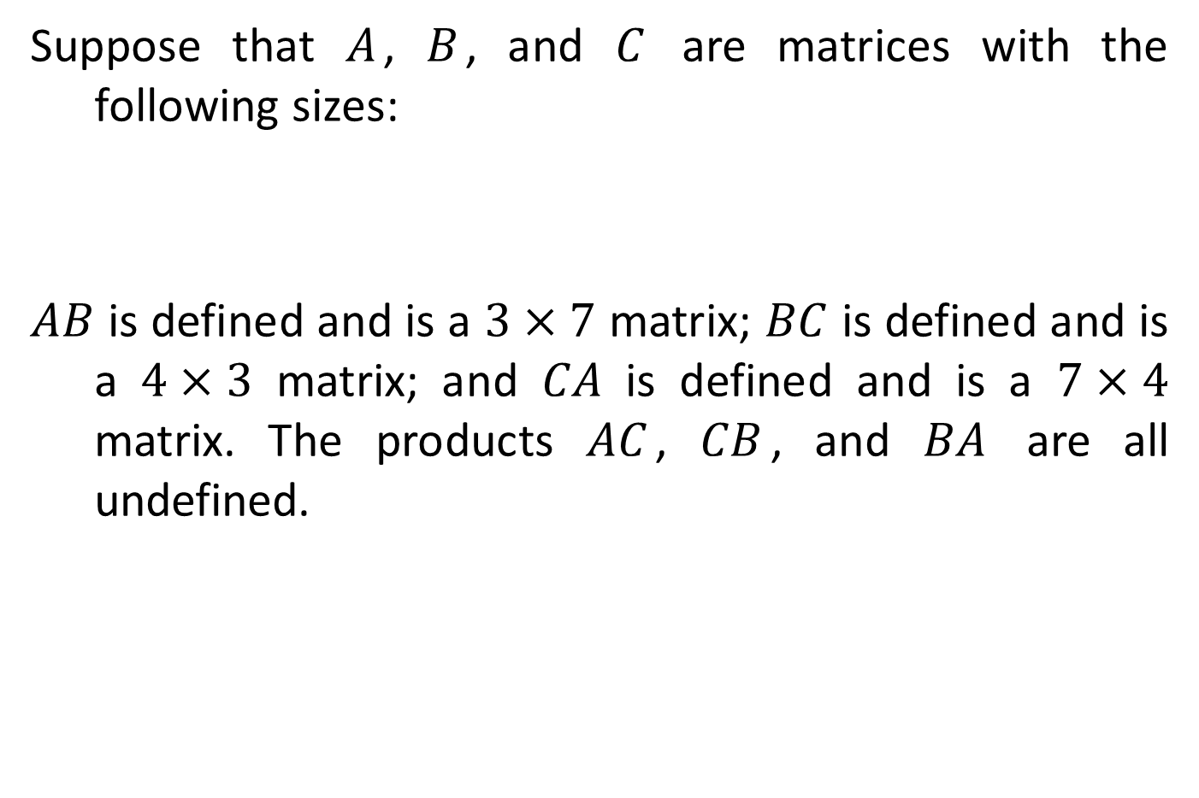
Suppose that $A$, $B$, and $C$ are matrices with the following sizes:
$AB$ is defined and is a $3×7$ matrix; $BC$ is defined and is a $4×3$ matrix; and $CA$ is defined and is a $7×4$ matrix. The products $AC$, $CB$, and $BA$ are all undefined.

Slide 19
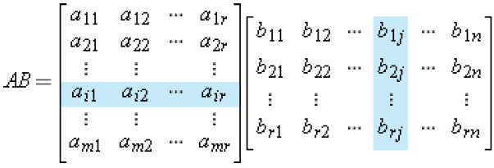
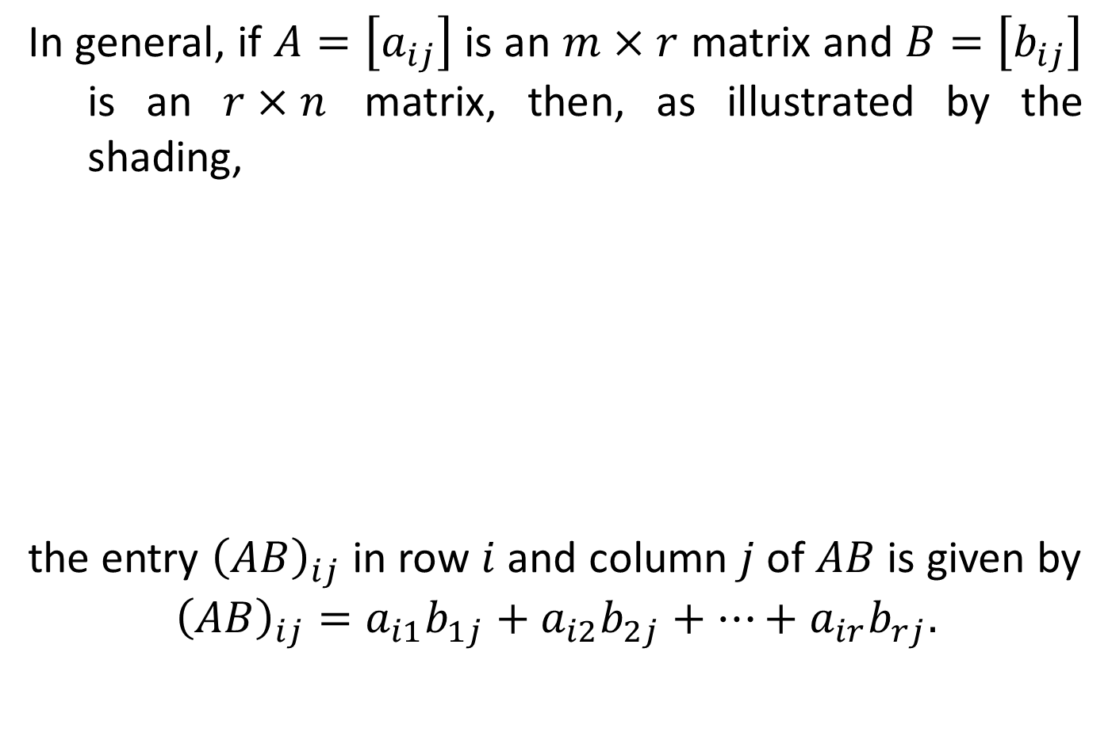
In general, if $A=\left[a_{ij}\right]$ is an $m×r$ matrix and $B=\left[b_{ij}\right]$ is an $r×n$ matrix, then, as illustrated by the shading,
the entry ${\left(AB\right)}_{ij}$ in row $i$ and column $j$ of $AB$ is given by
$${\left(AB\right)}_{ij}=a_{i1}b_{1j}+a_{i2}b_{2j}+⋯+a_{ir}b_{rj}.$$

Slide 20
Determinant
Definition:
The determinant of a matrix is a number assigned to every square matrix. The determinant of a matrix A is denoted by det(A) or $\left|A\right|$.
For a 2x2 matrix, the determinant is defined as:
For a 3x3 matrix, the determinant is:

Slide 22
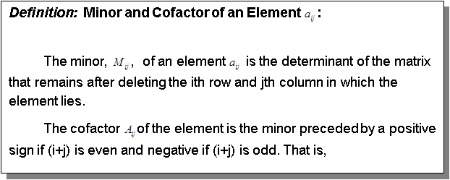
Remarks:
Properties of Determinants
1. The determinant of a matrix and its transpose are equal.
2. If two rows (columns) of a determinant are interchanged, the value of the resulting determinant is the negative of the given determinant.

Slide 23
3. If two rows (columns) of a determinant are identical, the determinant is zero.
4. If the elements of a row (column) of a determinant is multiplied by a scalar quantity k , the resulting determinant is k times the given determinant.
5. The value of the determinant is not changed if a row (column) is replaced by that row plus a multiple of another.
Examples: Evaluate the following determinants (use the properties whenever possible):

Slide 24
Solve for X to make the statement true:
Exercises:
Determine the determinants of the following matrices.

Slide 25
Systems of Linear and Non-Linear Equations and Inequalities

Slide 26
SPECIFIC OBJECTIVES:
At the end of the lesson, the student is expected to be able to:
Identify the type of linear system.
Determine the solution of a system of equations using any of the following analytical methods:
Elimination of a variable by addition/subtraction of equations
Elimination of a variable by substitution
Cramer’s Rule
Determine the solution of system of inequalities
Solve application problems in system of equations/inequalities

Slide 27
Definition: System of Linear Equations
A system of linear equations is a set of linear equations/inequalities having the same solution set.
The following are system of linear equations.
$\left\{\begin{aligned}3x+4y−9=0 \\ −2x+5y−8=0\end{aligned}\right.$ 2. $\left\{\begin{aligned}8x+4y−3=0 \\ −x−y=7\end{aligned}\right.$
3. $\left\{\begin{aligned}7x−y+8z=10 \\ x+4y+5z=2 \\ −5x+2y+8z=3\end{aligned}\right.$ 4. $\left\{\begin{aligned}6x+2y−z=6 \\ 2x−4y+7z−3=0 \\ x−y+z=10\end{aligned}\right.$

Slide 28
Types of System of Linear Equations
1. Independent or consistent system
a. System of equations in two or more variables represented by curves intersecting at a common point.
b. Have finite number of solutions represented by the points of intersection of the curves.
2. Inconsistent system
a. System of equations in two or more variables represented by non- intersecting curves.
b. System with no solution
3. Dependent system
a. System of equations in two or more variables represented by curves coincident with one another.
b. System with infinite number of solutions.

Slide 29
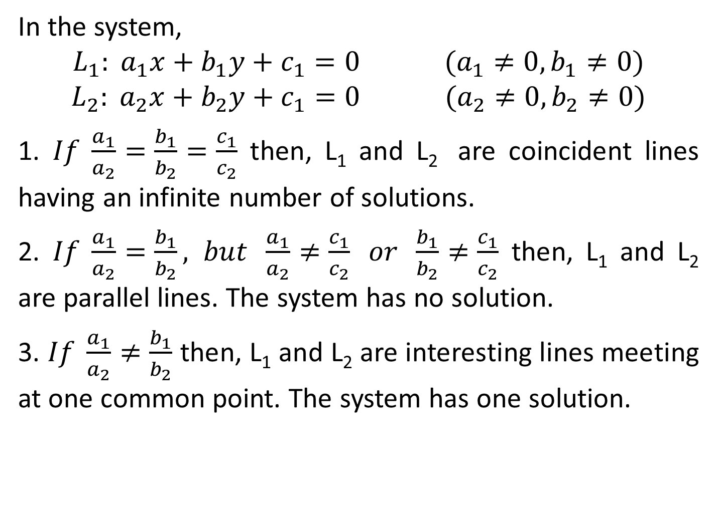
In the system,
$$L_{1}: a_{1}x+b_{1}y+c_{1}=0 (a_{1}≠0, b_{1}≠0)$$
$$L_{2}: a_{2}x+b_{2}y+c_{1}=0 (a_{2}≠0,b_{2}≠0)$$
1. $If \frac{a_{1}}{a_{2}}=\frac{b_{1}}{b_{2}}=\frac{c_{1}}{c_{2}}$ then, L₁ and L₂ are coincident lines having an infinite number of solutions.
2. $If \frac{a_{1}}{a_{2}}=\frac{b_{1}}{b_{2}}, but \frac{a_{1}}{a_{2}}≠\frac{c_{1}}{c_{2}} or \frac{b_{1}}{b_{2}}≠\frac{c_{1}}{c_{2}}$ then, L₁ and L₂ are parallel lines. The system has no solution.
3. $If \frac{a_{1}}{a_{2}}≠\frac{b_{1}}{b_{2}}$ then, L₁ and L₂ are interesting lines meeting at one common point. The system has one solution.

Slide 30
Solving System of Linear Equations
1. Elimination Of a Variable by Addition/Subtraction
This is an analytical method of solving a system of equations that eliminates a variable addition/subtraction of multiple equations.
2. Elimination Of a Variable by Substitution
This is an analytical method of solving a system of equations that eliminates a variable by replacing one of the variables in one of the equations by an equal expressions obtained from the other equation.
3. Cramer’s Rule
Cramer’s Rule is an analytical method of solving a system of equations by using determinants.

Slide 31

For a 2-variable system:
$$a_{1}x+b_{1}y=c_{1}$$
$$a_{2}x+b_{2}y=c_{2}$$
Where $a_{1}≠0 or b_{1}≠0$ and either $a_{2}≠0 or b_{2}≠0$
Let,
Then,
For a 3-variable system:
$$a_{1}x+b_{1}y+c_{1}z=d_{1}$$
$$a_{2}x+b_{2}y+c_{2}z=d_{2}$$
$$a_{3}x+b_{3}y+c_{3}z=d_{3}$$

Slide 32
where at least one of the coefficient is nonzero.
Let,
Then,

Slide 33

Examples: Solve each of the following applying any analytical method.
1. $\begin{matrix}x+2y=5 \\ 3x+2y=11\end{matrix}$ 2. $\begin{matrix}\frac{x}{3}+\frac{y}{2}=\frac{11}{6} \\ \frac{x}{4}−\frac{y}{3}=−\frac{3}{4}\end{matrix}$
3. $\begin{matrix}\frac{1}{x}−\frac{4}{y}=3 \\ \frac{2}{x}−\frac{5}{y}=3\end{matrix}$ 4. $\begin{matrix}x−2y−z=3 \\ x+y+z=4 \\ x−3y−z=4\end{matrix}$

Slide 34
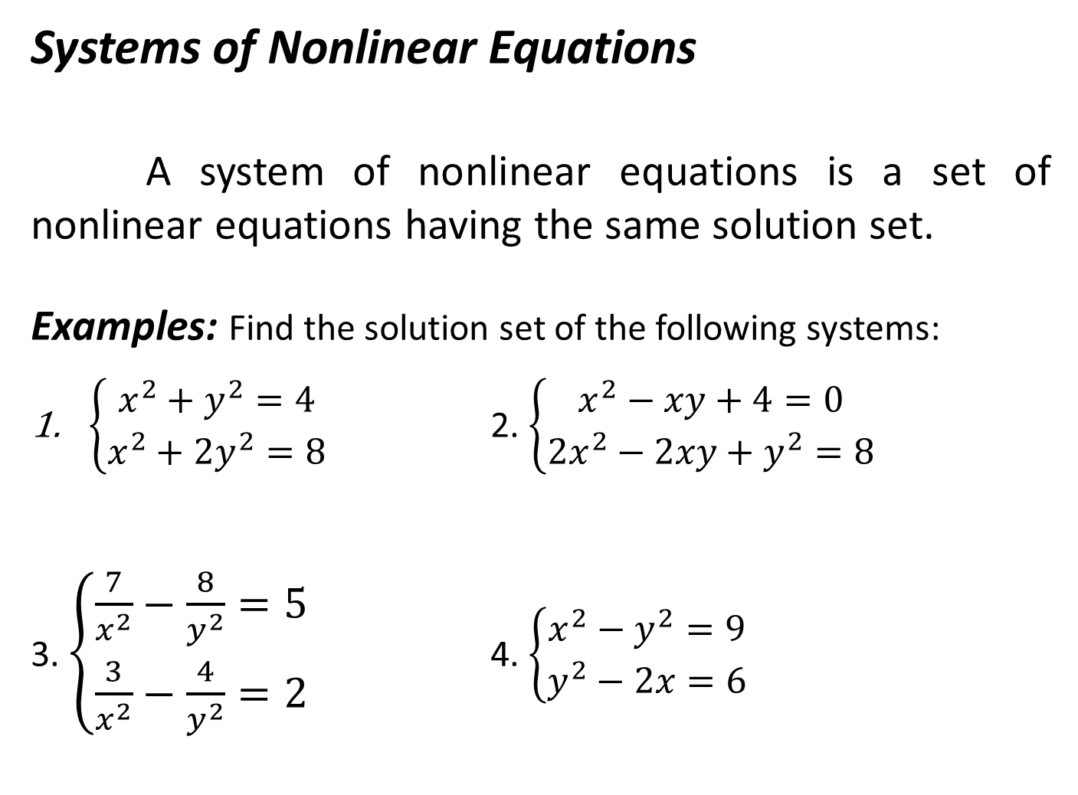
Systems of Nonlinear Equations
A system of nonlinear equations is a set of nonlinear equations having the same solution set.
Examples: Find the solution set of the following systems:
$\left\{\begin{matrix}x^{2}+y^{2}=4 \\ x^{2}+{2y}^{2}=8\end{matrix}\right.$ 2. $\left\{\begin{matrix}x^{2}−xy+4=0 \\ {2x}^{2}−2xy+y^{2}=8\end{matrix}\right.$
3. $\left\{\begin{matrix}\frac{7}{x^{2}}−\frac{8}{y^{2}}=5 \\ \frac{3}{x^{2}}−\frac{4}{y^{2}}=2\end{matrix}\right.$ 4. $\left\{\begin{matrix}x^{2}−y^{2}=9 \\ y^{2}−2x=6\end{matrix}\right.$

Slide 35
Partial Fractions

Slide 36
SPECIFIC OBJECTIVES:
At the end of the lesson, the student is expected to be able to:
• define partial fractions.
• identify the different cases of partial fractions.
• decompose fraction into partial fractions

Slide 37
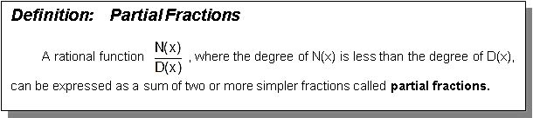
Remarks:
If the rational function $\frac{N(x)}{D(x)}$ is an improper fraction, that is, the degree of N(x) is greater than or equal to the degree of D(x), divide N(x) by D(x) until a proper fraction is obtained.

Slide 38
The denominators of the partial fractions are obtained by expressing D(x) into a product of linear and/or quadratic factors. The method of determining the partial fractions depends on the nature of the factors of D(x). This leads to any of the four cases as follows:
1. Distinct linear factors
2. Repeated linear factors
3. Distinct quadratic factors
4. Repeated quadratic factors

Slide 39
Determination of Constants in the Partial Fractions
There two ways to find the constants in the partial fractions, namely:
1. By assigning values to the variable
This method uses the concept that if two polynomials are identical, then they are equal for any value assigned to the variable. The most convenient values are those that will make the denominator of the given rational function zero.
2. By equating like powers of the variable
This method uses the concept that if two polynomials are identical, then the coefficient of each power of the variable in one polynomial is equal to the corresponding coefficient in the other polynomial.

Slide 40
Fraction Decomposition
Distinct Linear Factor
For every distinct linear factor of the form $ax+b$ found in $D(x)$, there corresponds a partial fraction of the form $\frac{A}{a_{1}x+b_{1}}+\frac{B}{a_{2}x+b_{2}}+\frac{C}{a_{3}x+b_{3}}+…+\frac{N}{a_{n}x+b_{n}}$, where A, B, C, …, N are constants to be determined.
Examples: Decompose the following fractions into partial fractions.
1. $\frac{2x+3}{{2x}^{2}+x−6}$ 2. $\frac{x^{4}+{3x}^{2}+1}{x^{3}−x}$

Slide 41
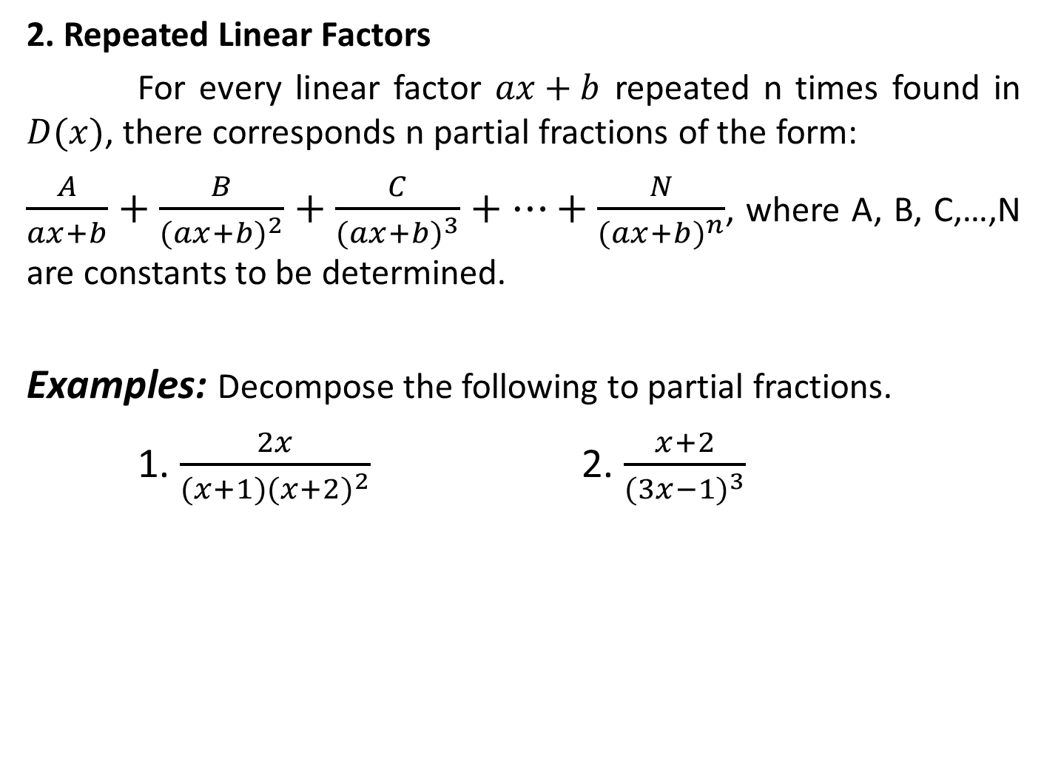
2. Repeated Linear Factors
For every linear factor $ax+b$ repeated n times found in $D(x)$, there corresponds n partial fractions of the form:
$\frac{A}{ax+b}+\frac{B}{{(ax+b)}^{2}}+\frac{C}{{(ax+b)}^{3}}+…+\frac{N}{{(ax+b)}^{n}}$, where A, B, C,…,N are constants to be determined.
Examples: Decompose the following to partial fractions.
1. $\frac{2x}{(x+1){(x+2)}^{2}}$ 2. $\frac{x+2}{{(3x−1)}^{3}}$

Slide 42
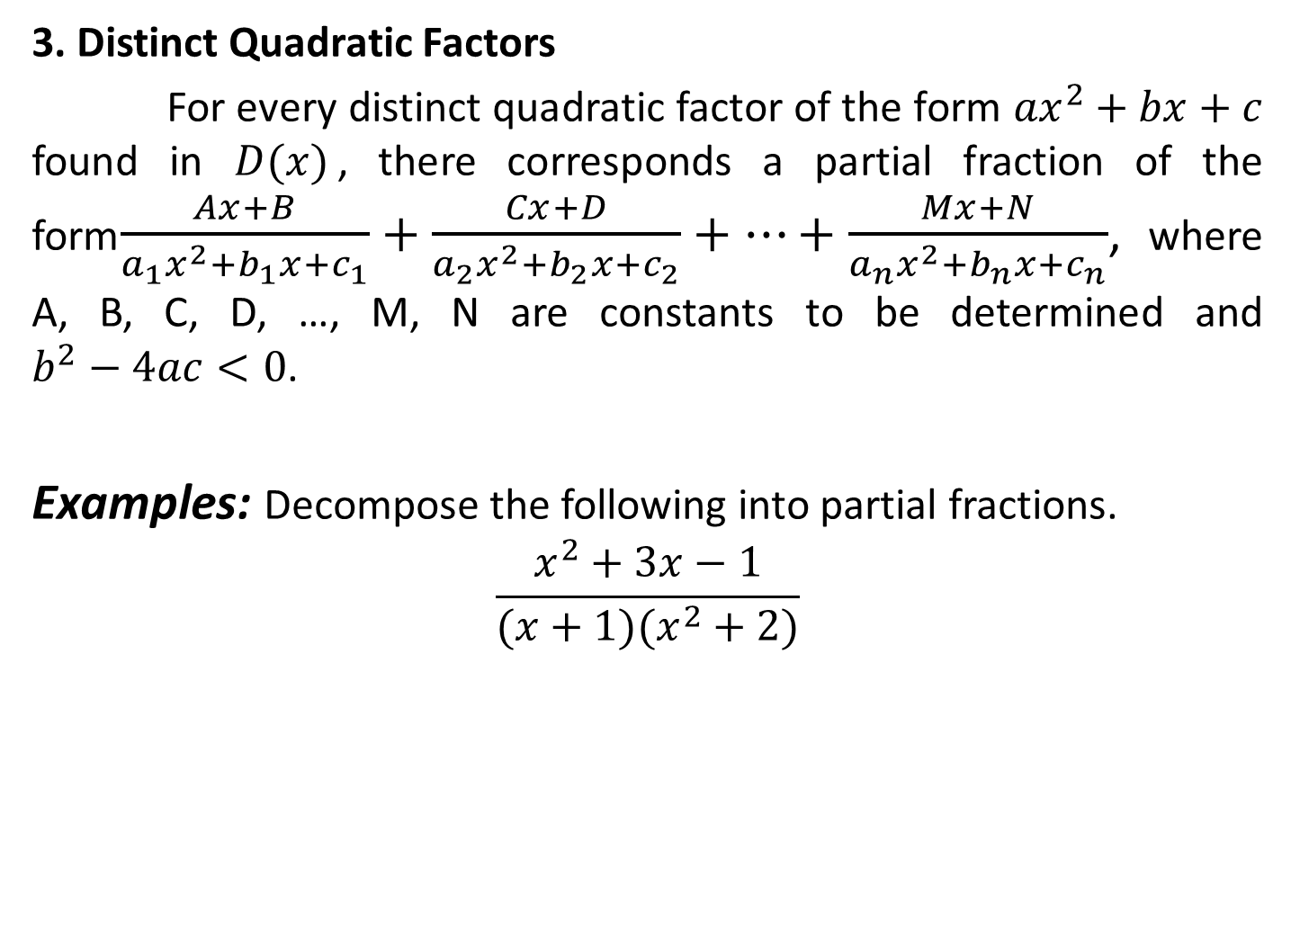
3. Distinct Quadratic Factors
For every distinct quadratic factor of the form ${ax}^{2}+bx+c$ found in $D(x)$, there corresponds a partial fraction of the form$\frac{Ax+B}{a_{1}x^{2}+b_{1}x+c_{1}}+\frac{Cx+D}{a_{2}x^{2}+b_{2}x+c_{2}}+…+\frac{Mx+N}{a_{n}x^{2}+b_{n}x+c_{n}}$, where A, B, C, D, …, M, N are constants to be determined and $b^{2}−4ac<0$.
Examples: Decompose the following into partial fractions.
$$\frac{x^{2}+3x−1}{(x+1)(x^{2}+2)}$$

Slide 43
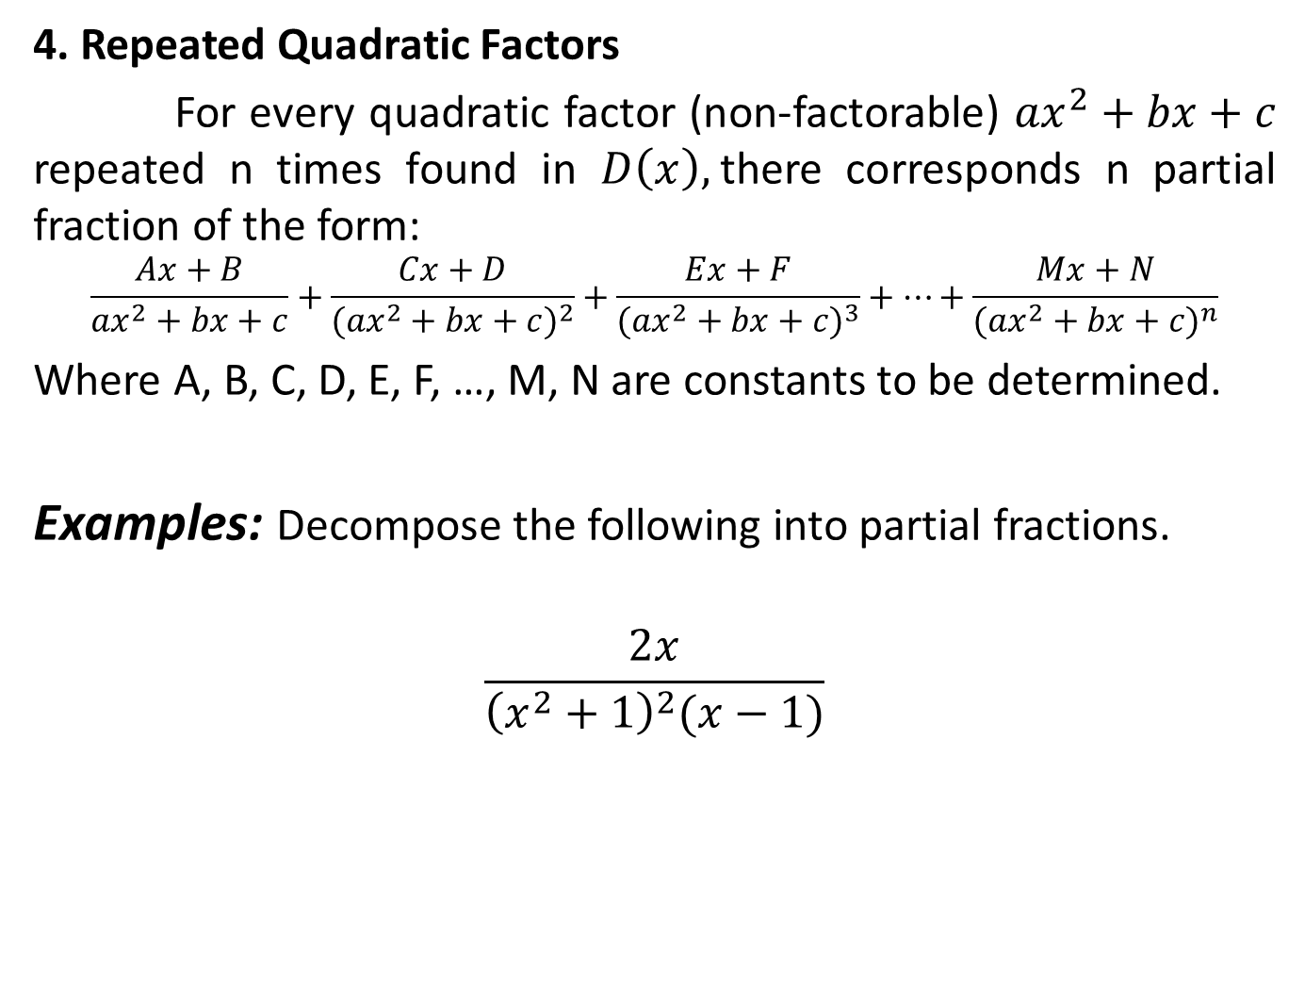
4. Repeated Quadratic Factors
For every quadratic factor (non-factorable) ${ax}^{2}+bx+c$ repeated n times found in $D\left(x\right),$there corresponds n partial fraction of the form:
$$\frac{Ax+B}{{ax}^{2}+bx+c}+\frac{Cx+D}{{({ax}^{2}+bx+c)}^{2}}+\frac{Ex+F}{{({ax}^{2}+bx+c)}^{3}}+…+\frac{Mx+N}{{({ax}^{2}+bx+c)}^{n}}$$
Where A, B, C, D, E, F, …, M, N are constants to be determined.
Examples: Decompose the following into partial fractions.
$$\frac{2x}{{\left(x^{2}+1\right)}^{2}(x−1)}$$

Slide 44
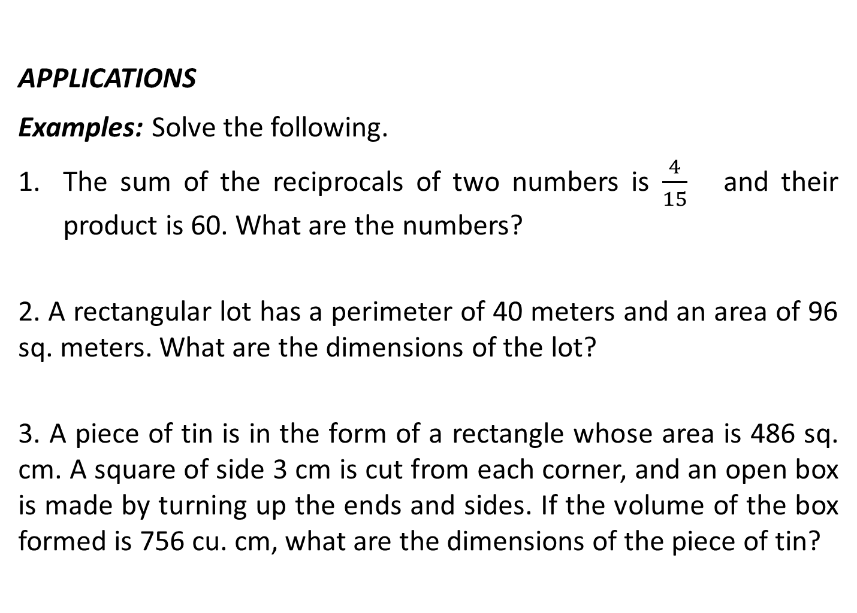
APPLICATIONS
Examples: Solve the following.
The sum of the reciprocals of two numbers is $\frac{4}{15}$ and their product is 60. What are the numbers?
2. A rectangular lot has a perimeter of 40 meters and an area of 96 sq. meters. What are the dimensions of the lot?
3. A piece of tin is in the form of a rectangle whose area is 486 sq. cm. A square of side 3 cm is cut from each corner, and an open box is made by turning up the ends and sides. If the volume of the box formed is 756 cu. cm, what are the dimensions of the piece of tin?

Slide 45
4. A number has four digits. The first digit is equal to the square of the third. The second digit is the same as the third and the last is 2 less than the first. If the sum of the first and the last digits is 16, what is the four digit number?
5. A cyclist travelled a certain distance at her usual speed. If her speed had been 2 mi/hr faster, she would have travelled the distance in 1 hr. less time. If her speed had been 2 mi/hr slower, she would have taken 2 hr. longer. Find the distance travelled and her usual speed.

Slide 46
System of Linear Inequalities
A system of linear inequalities is a set of inequalities. The system maybe be consistent or inconsistent depending on whether it has a solution or not.
The solution to a system of inequalities is the set of all points ( x , y ) such that every inequality in the system is satisfied. Graphically, the solution is the common region to all inequalities in the system.

Slide 47
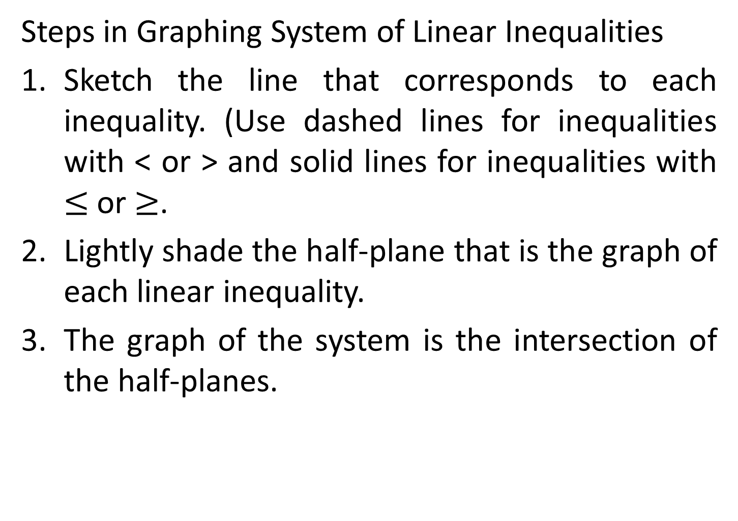
Steps in Graphing System of Linear Inequalities
Sketch the line that corresponds to each inequality. (Use dashed lines for inequalities with < or > and solid lines for inequalities with $≤$ or $≥$.
Lightly shade the half-plane that is the graph of each linear inequality.
The graph of the system is the intersection of the half-planes.

Slide 48
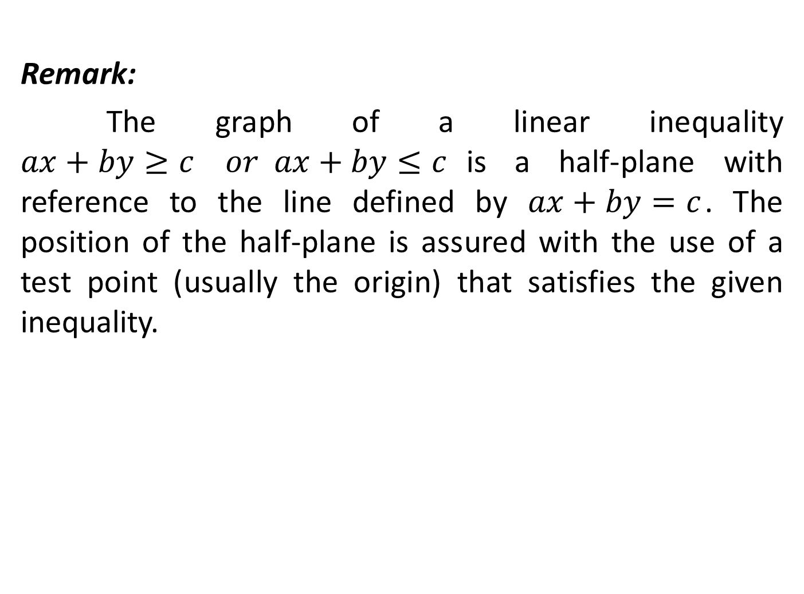
Remark:
The graph of a linear inequality $ax+by≥c or ax+by≤c$is a half-plane with reference to the line defined by $ax+by=c$. The position of the half-plane is assured with the use of a test point (usually the origin) that satisfies the given inequality.

Slide 49

Examples: Draw the graph and sketch the common region:
1. $\left\{\begin{matrix}y−2x≤4 \\ 2x+y≤4\end{matrix}\right.$ 2. $\left\{\begin{matrix}4x+y≥6 \\ 6x−2y≤7\end{matrix}\right.$
3. $\left\{\begin{matrix}3x−4y≤12 \\ \begin{matrix}x+2y≥2 \\ \begin{matrix}x≥0 \\ y≥0\end{matrix}\end{matrix}\end{matrix}\right.$

Slide 50
LINEAR PROGRAMMING
Linear Programming is a mathematical technique used to determine the optimal allocation of resources in business, the military, and other areas of human endeavor. A two variable linear programming consists of:
An objective function that expresses the quantity to be maximized or minimized.
A system of constraint linear inequalities whose solution set represents the set of feasible solutions.

Slide 51
Guidelines for Solving a Linear Programming Problem
Sketch the region corresponding to the system of constraints. The points inside or on the boundary of the region are called the feasible solutions.
Find the vertices of the region.
Test the objective function at each of the vertices and select the values of the variable that optimize the objective function. For a bounded region, both a minimum and a maximum value will exist. For unbounded region, if an optimal solution exist, it will occur at a vertex.

Slide 52
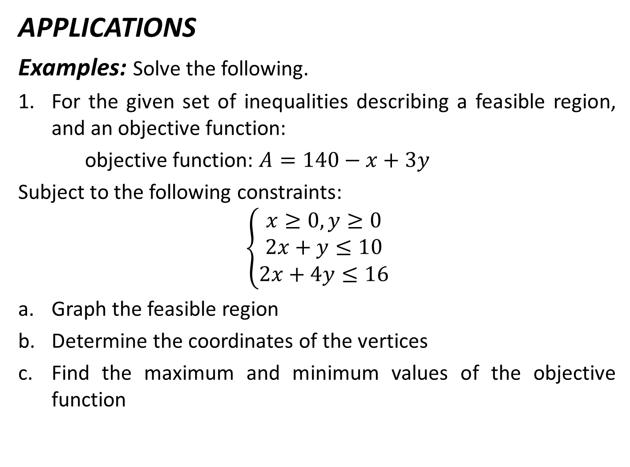
APPLICATIONS
Examples: Solve the following.
For the given set of inequalities describing a feasible region, and an objective function:
objective function: $A=140−x+3y$
Subject to the following constraints:
$$\left\{\begin{matrix}x≥0, y≥0 \\ 2x+y≤10 \\ 2x+4y≤16\end{matrix}\right.$$
Graph the feasible region
Determine the coordinates of the vertices
Find the maximum and minimum values of the objective function

Slide 53
2. The FC Biscuit Factory makes two flavor of biscuits, chocolate and butter. The oven can cook at most 30 biscuits per hour. Chocolate-flavored each requires 2 oz. of flour, butter-flavored requires 1 oz. of flour, and there is at most 50 oz. of flour available. The income from chocolate-flavored biscuits is P10 and from butter-flavored is P8. How many of each type of biscuit should be made in order to maximize income? What is the maximum income?

Slide 54
3. ABC sells refrigerators and television sets. To stay in business, it must sell 10 refrigerators each month, but it does not have enough stock to sell more than 60 refrigerators or more than 120 television sets. The total inventory of refrigerators and television sets cannot exceed 160. The profit on a refrigerator is P1340 and on a television set , P200. Find the number of each that should be sold in order to maximize the profit.

Slide 55
4. John is about to take a test that contains short-answered questions worth 4 points each and word problems worth 7 points each. He must do at least 5 short-answered questions, but time restricts doing more than 10. He must do at least 3 word problems, but time restricts doing more than 10. He can do no more than 18 questions in total. How many of each type of questions must he do to maximize his score? What is the maximum score?

Slide 56
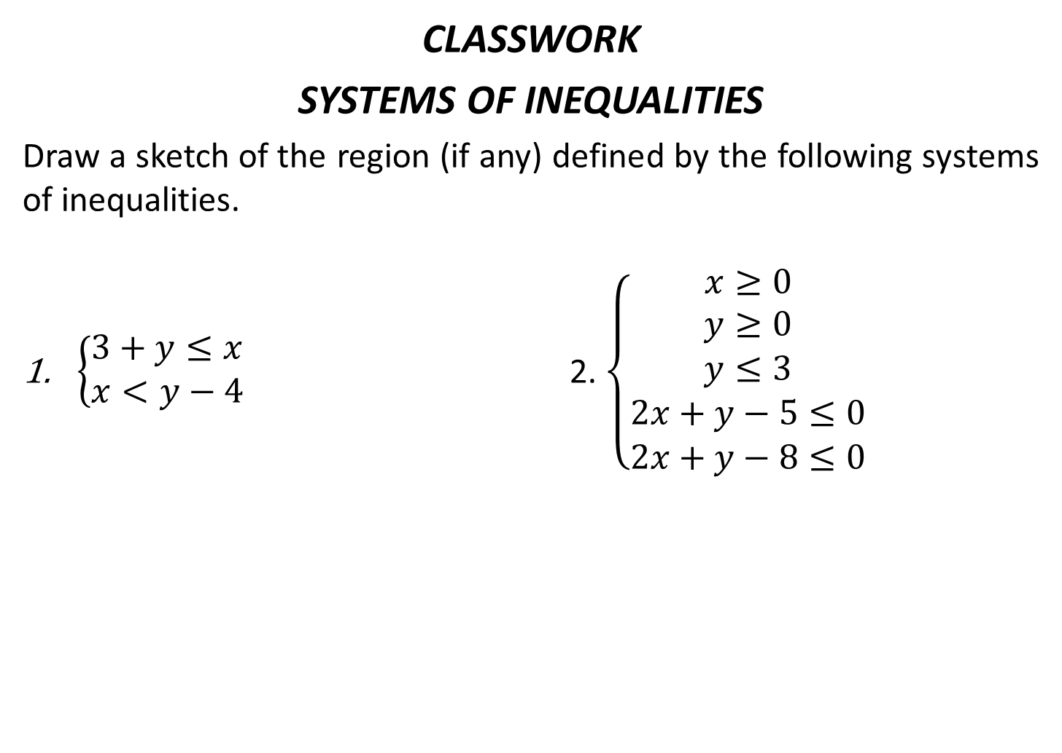
CLASSWORK
SYSTEMS OF INEQUALITIES
Draw a sketch of the region (if any) defined by the following systems of inequalities.
$\left\{\begin{matrix}3+y≤x \\ x<y−4\end{matrix}\right.$ 2. $\left\{\begin{matrix}x≥0 \\ y≥0 \\ \begin{matrix}y≤3 \\ 2x+y−5≤0 \\ 2x+y−8≤0\end{matrix}\end{matrix}\right.$

